Slide 1
Simulations with Simon
A Denison Project Presentation

Slide 2
The goal is to simulate quantum systems on a quantum computer.
What systems can we simulate?
How efficient is it?
What sort of errors are introduced?

Slide 3
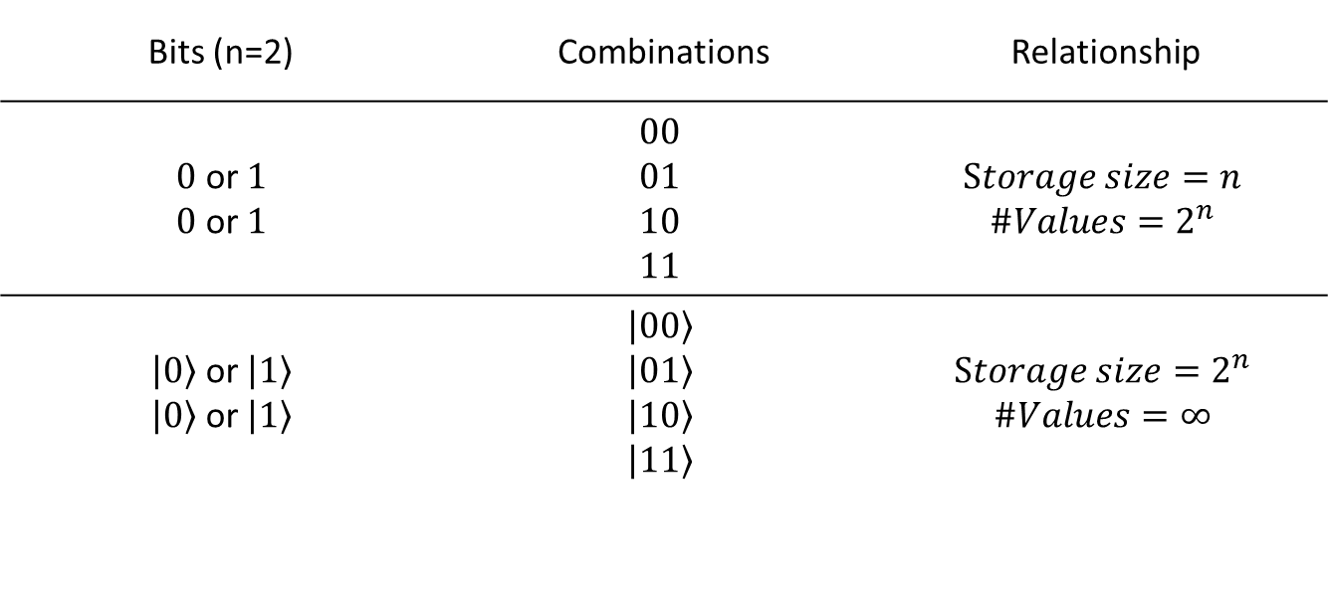
The Basics of Quantum Computers
Bits (n=2) | Combinations | Relationship
$0$ or $1$ $0$ or $1$ | $$00$$ $$01$$ $$10$$ $$11$$ | $$Storage size=n$$ $$\#Values=2^{n}$$
$\left|\left.0\right\rangle \right.$ or $\left|\left.1\right\rangle \right.$ $\left|\left.0\right\rangle \right.$ or $\left|\left.1\right\rangle \right.$ | $$\left|\left.00\right\rangle \right.$$ $$\left|\left.01\right\rangle \right.$$ $$\left|\left.10\right\rangle \right.$$ $$\left|\left.11\right\rangle \right.$$ | $$Storage size=2^{n}$$ $$\#Values=∞$$

Slide 4


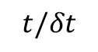
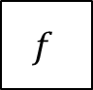
Running simulations on a quantum computer
$$t/δt$$
$$U\left(δt\right)=e^{−i\hat{H}(δt)}$$
Useful Information
$$\left|\left.ψ\right\rangle \right.$$
$$f$$

Slide 5





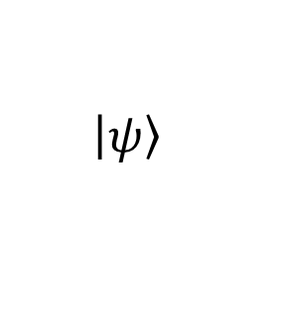

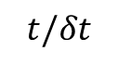
The split operator Fourier transform method From Zalka and Wiesner
$$t/δt$$
$$\hat{𝒱}=e^{−i\hat{V}δt}$$
$$\hat{𝒯}=e^{−i\hat{T}δt}$$
Useful Information
$$\left|\left.ψ\right\rangle \right.$$
$$iQFT$$
$$QFT$$
$$f$$
$$e^{−i\hat{H}δt}≈e^{−i\hat{T}δt}e^{−i\hat{V}δt}$$

Slide 6


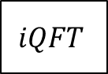
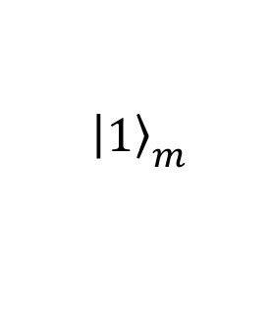
A Polynomial Time Method with Phase Kickback
$$t/δt$$
$$\hat{𝒱}$$
$$\hat{𝒯}$$
Useful Information
$$\left|\left.ψ\right\rangle \right.$$
$$iQFT$$
$$QFT$$
$$f$$
$${\left|\left.1\right\rangle \right.}_{m}$$
$$iQFT$$

Slide 7
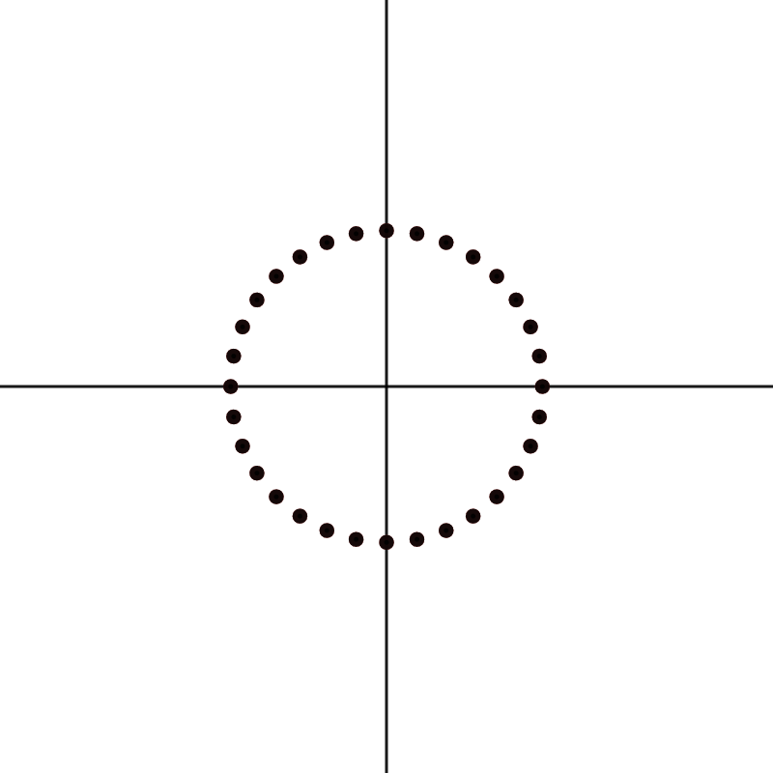
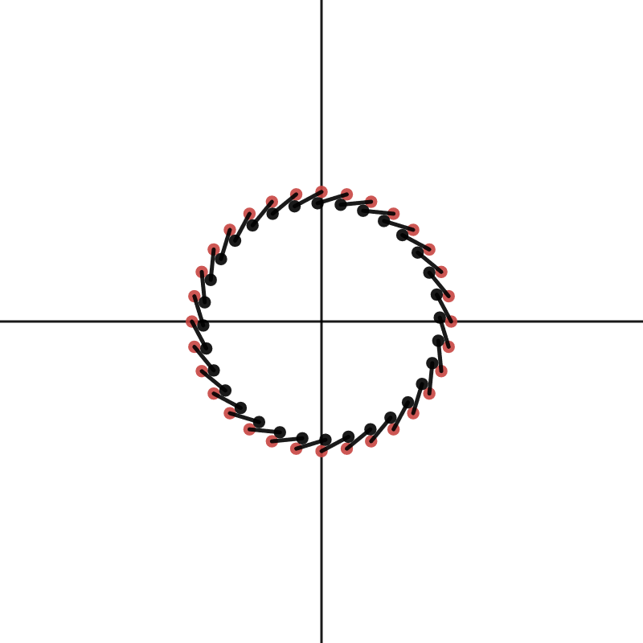
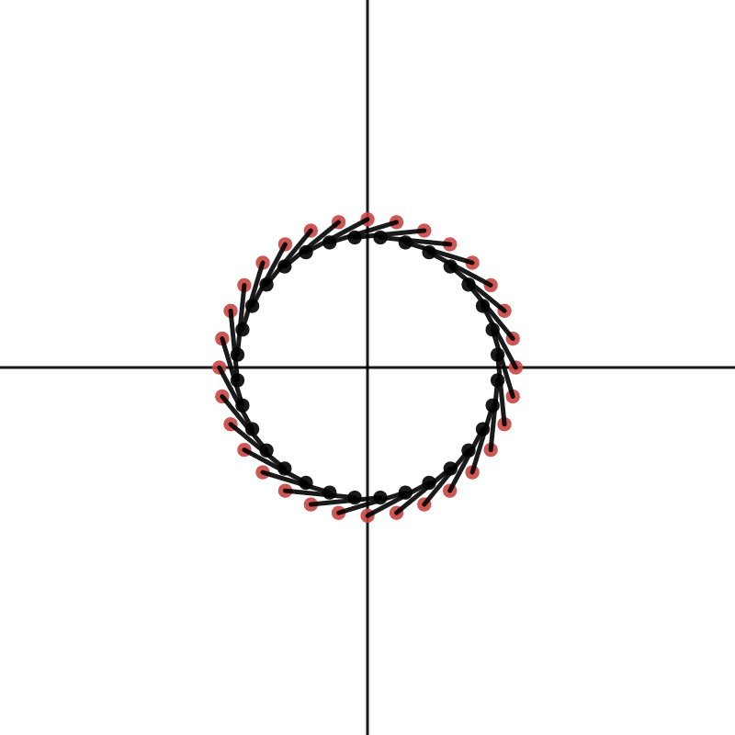
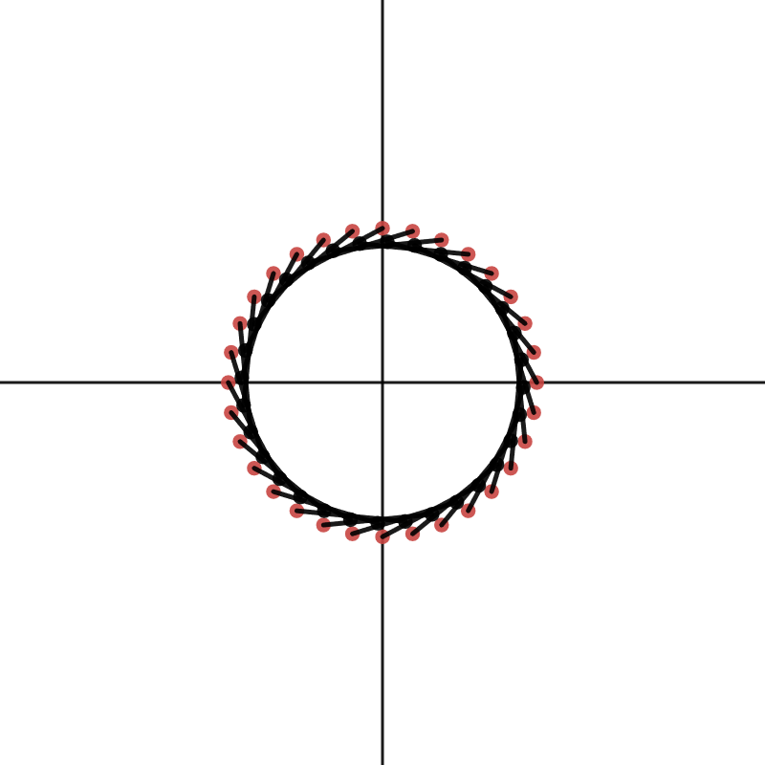
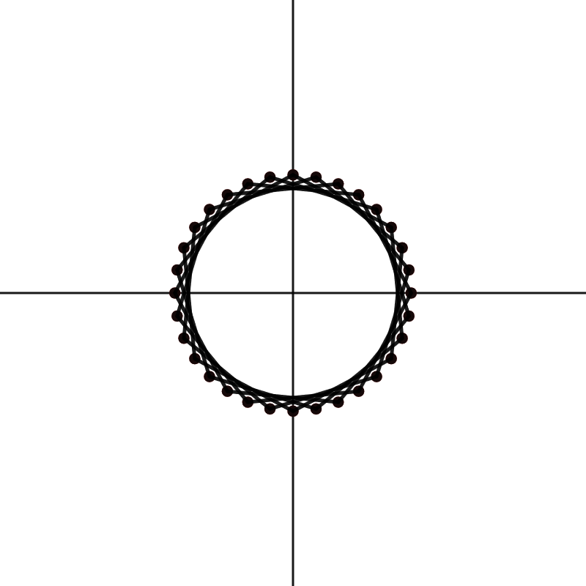




Implementing $\hat{𝒱}$ with phase kickback
$$\left|\left.y\right\rangle \right.=\frac{1}{\sqrt{2^{m}}}\sum_{y=0}^{2^{m}−1}{e^{\frac{2πiy}{2^{m}}}}\left|\left.y\right\rangle \right.$$
$$\left|\left.x,y\right\rangle \right.\underset{→}{Gate Sequence}\left|\left.x,V(x)⊕y\right\rangle \right.$$
$$\left|\left.x,y\right\rangle \right.\underset{→}{Gate Sequence}\left|\left.x,e^{\frac{2πiV\left(x\right)}{2^{m}}} y\right\rangle \right.$$

Slide 8
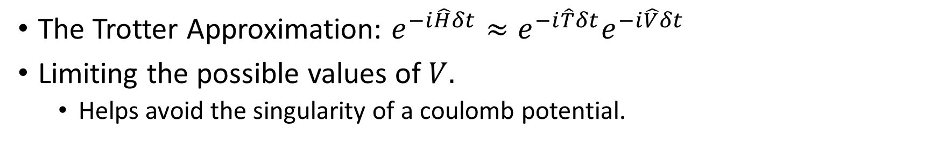


Errors in $\hat{𝒱}$
The Trotter Approximation: $e^{−i\hat{H}δt}≈e^{−i\hat{T}δt}e^{−i\hat{V}δt}$
Limiting the possible values of $V.$
Helps avoid the singularity of a coulomb potential.
$$\frac{−1}{r}↦\frac{−1}{r+Δ}$$

Slide 9
What I’ve been doing

Slide 10
A simulation of the exact solution of a quantum harmonic oscillator.

Slide 11
A quantum harmonic oscillator using the SOFT Method

Slide 12
Putting a Free Particle Into The Simulation

Slide 13
Putting a Coulomb Potential Into the Simulation

Slide 14

Varying the $V_{max}$ of a Coulomb Potential

Slide 15
Varying the grid spacing of a Coulomb Potential

Slide 16

Varying the grid spacing with a constant $V_{max}$

Slide 17
A 3D Quantum Harmonic Oscillator

Slide 18
A 3D Coulomb Potential

Slide 19
Simulations with Simon
A Denison Project Presentation

